Slide 1

MATH 323
Graph Theory
Cr. 3
Dr. Bhadra Man Tuladhar
MATH 323 Graph Theory Lecture 10

Slide 2
Regular Polyhedra
If a polyhedron has V vertices, E edges and F faces, then
V - E + F = 2.
Compare this formula with Euler’s formula for connected planar graph.
r = e – n + 2
MATH 323 Graph Theory Lecture 10

Slide 3
Regular Polyhedra
For polyhedron has V vertices, E edges and F faces, then
V - E + F = 2.
For connected planar graph.
r = e – n + 2 ➔ n – e + r =2
So Polyhedra can be viewed as a planar graph, where the faces are regions.
MATH 323 Graph Theory Lecture 10

Slide 4
Polyhedra as graph
Imagine taking hold of the faces and stretching it to form a graph.
Polyhedra
MATH 323 Graph Theory Lecture 10
Planar graph

Slide 5
Regular Polyhedra
A regular polygon is one that is equilateral and equiangular.
We say a plyhedron is regular if its faces are mutually congruent, regular polygons and if the number of faces meeting at a vertex is the same for every vertex.
MATH 323 Graph Theory Lecture 10

Slide 6
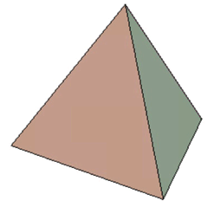
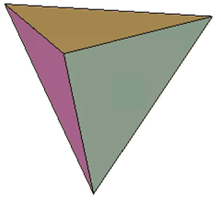
Five Regular Polyhedra
There are exactly five regular polyhedra.
They are:
Tetrahedron: V = F = 4
Planar graph
MATH 323 Graph Theory Lecture 10

Slide 7
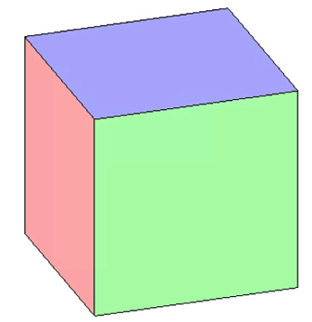
Five Regular Polyhedra
2. Cube: V=8, F = 6
Planar graph
MATH 323 Graph Theory Lecture 10

Slide 8
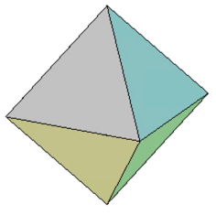
Five Regular Polyhedra
3. Octahedron:- V=6, F=8
Planar graph
MATH 323 Graph Theory Lecture 10

Slide 9
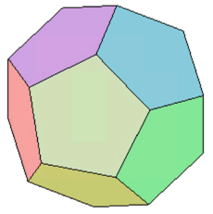
Five Regular Polyhedra
4. Dodecahedron:- V=20, F = 12
Planar graph
MATH 323 Graph Theory Lecture 10

Slide 10
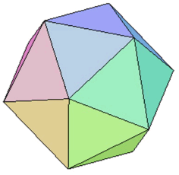
Five Regular Polyhedra
5. Icosahedron:- V=12, F=20
Planar graph
MATH 323 Graph Theory Lecture 10

Slide 11
Dual Graph
Suppose G is a plane graph. The dual graph G* of G is a plane graph having a vertex for each region in G. The edges of G* correspond to the edges of G as follows:
If e is an edge of G that has region X on one side and region Y on the other side, then the corresponding dual edge e* ∈ E(G*) is an edge joining the vertices x, y of G* that correspond to the face X, Y of G.
MATH 323 Graph Theory Lecture 10

Slide 12
Example of dual graph
The graph G is in yellow color. The corresponding dual graph g* is in white.
MATH 323 Graph Theory Lecture 10

Slide 13
Theorem
A graph has a dual if and only if it is planar.
MATH 323 Graph Theory Lecture 10

Slide 14
Self-dual Graphs
If a planar graph G is isomorphic to its own dual, it is called self-dual graph.
Exercise:
Show that the four-vertex complete graph is self-dual.
MATH 323 Graph Theory Lecture 10

Slide 15
Euler Graphs
If some closed walk in a graph contains all the edges of the graph, then the walk is called an Euler line (Eulerian circuit) and the graph an Euler graph.
Note:
- Euler graph is always connected.
MATH 323 Graph Theory Lecture 10

Slide 16
Theorem
A given connected graph G is an Euler graph if and only if all its vertices of G are of even degree.
MATH 323 Graph Theory Lecture 10

Slide 17
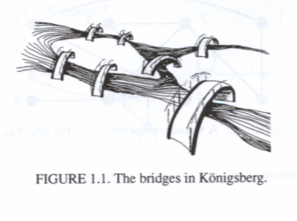
Königsberg Bridge
(1700)
To walk across a route that crossed each of these bridges exactly once.
In 1736 Leonhard Euler gave a negative proof.
A
C
D
B
MATH 323 Graph Theory Lecture 10

Slide 18
Graph of Königsberg Bridge
Euler represented this situation by means of a graph. The vertices represent the land areas and the edges represent the bridges.
A
A
C
C
D
D
B
B
MATH 323 Graph Theory Lecture 10

Slide 19
Graph of Königsberg Bridge
Euler represented this situation by means of a graph. The vertices represent the land areas and the edges represent the bridges.
A
All its vertices are odd.
It is not a Euler graph.
Not possible to walk over each of the 7 bridges exactly once and return to the starting point.
C
D
B
MATH 323 Graph Theory Lecture 10

Slide 20
Exercise
1. Show that the following graphs are Eulerian.
MATH 323 Graph Theory Lecture 10

Slide 21
Exercise
2. What additional bridges would be needed in Königsberg city to make the routes of the city an Eulerian graph.
3. Give an example of a graph with 12 vertices which is Eulerian.
MATH 323 Graph Theory Lecture 10

Slide 22
Hamiltonian Circuit
A Hamiltonian circuit in a connected graph is defined as a closed walk that traverses every vertex of G exactly once, except the starting vertex, at which the walk also terminates.
Note:
- a Hamiltonian circuit in a graph of n vertices consists of exactly n edges.
MATH 323 Graph Theory Lecture 10

Slide 23
Hamiltonian Path
By removing any one edge of a Hamiltonian circuit we obtain a Hamiltonian Path.
Note:
Hamiltonian path in a graph G traverses every vertex of G
Hamiltonian path is a subgraph of a Hamiltonian circuit.
The length of a Hamiltonian path in a connected graph of n vertices is n-1.
MATH 323 Graph Theory Lecture 10

Slide 24
Hamiltonian Graph
A graph G is Hamiltonian if it has a Hamiltonian circuit.
Note:
Every Eulerian graph is Hamiltonian.
Every Hamiltonian graph is Eulerian.
MATH 323 Graph Theory Lecture 10

Slide 25
Theorems
If G is a graph with n vertices such that for any two vertices v_{i} and v_{j} satisfying the condition d(v_{i}) + d(v_{j}) ≥ n-1, then G has a Hamiltonian path.
If G is a graph with p(≥3) vertices such that d(v) ≥ p/2 for every vertex v of G, then G is Hamiltonian.
MATH 323 Graph Theory Lecture 10

Slide 26
Examples
Hamiltonian Circuits:
MATH 323 Graph Theory Lecture 10

Slide 27
Exercise
Test for Eulerian circuits and Hamiltonian circuits in the graphs of regular polyhedron.
Draw a graph that has a Hamiltonian path but does not have a Hamiltonian circuit.
MATH 323 Graph Theory Lecture 10

Slide 28
Traveling Salesman Problem
A salesman is required to visit a number of cities during a trip. Given the distances between the cities, in what order should he travel so as to visit every city precisely once and return home, with the minimum mileage traveled?
MATH 323 Graph Theory Lecture 10

Slide 29
Solution
Representing the cities by vertices and the roads between them by edges with the mileage as weights, we get a weighted graph. If each of the cities has a road to every other city, we have complete weighted graph.
The total number of different Hamiltonian circuits in a complete graph of n vertices is equal to (n-1)!/2.
MATH 323 Graph Theory Lecture 10

Slide 30
Chinese Postman Problem
Consider a postman who begins delivering the mails in a city suburb having picked the mails from the post-office. He wishes to cover his route with minimum walking, as far as possible, and finally return to the post-office, traveling the least possible distance.
MATH 323 Graph Theory Lecture 10

Slide 31
Coloring of Graphs
The (proper) coloring of a graph is painting all the vertices of G with colors such that no two adjacent vertices have the same color.
Given a graph G, a k-coloring of the vertices of G is a partition of the vertex set V into k sets C₁, C₂, . . ., C_{k} such that for all i, no pair of vertices from C_{i} are adjacent. If such a partition exists, G is said to be k-colorable.
MATH 323 Graph Theory Lecture 10

Slide 32
Example
C₅ is 3-colorable.
a
C₁ ={a,c}
C₂ ={b,d}
e
b
C₃ ={e}
Coloring with two colors is impossible.
d
c
MATH 323 Graph Theory Lecture 10

Slide 33
Chromatic Number
Given a graph G, the chromatic number of G, denoted by χ(G), is the smallest integer k such that G is k-colorable.
χ(C₅) = 3.
MATH 323 Graph Theory Lecture 10

Slide 34
Chromatic number of some common graphs
        2 if n is even
χ(C_{n}) =
        3 if n is odd
        2 if n ≥ 2
χ(P_{n}) =
        1 if n = 1.
χ(K_{n}) = n
χ(K_{m},_{n}) = 2
MATH 323 Graph Theory Lecture 10

Slide 35
Theorem
Every tree with two or more vertices is 2-chromatic.
MATH 323 Graph Theory Lecture 10

Slide 36
Exercise
Find the chromatic number of
  The Petersen graph
  The Birkhoff diamond:-
MATH 323 Graph Theory Lecture 10

Slide 37
Exercise
2. In assigning frequencies to cellular phones, a zone gets a frequency to be used by all vehicles in the zone. Two zones that interfere must get different frequencies.
How many different frequencies are required if there are six zones, a, b, c, d, e, f and zone a interferes with zone b; b interfers with a, c, and d; c interferes with b, d, and e; d interferes with b, c, and e; e interferes with c, d, and f; and f interferes with e only?
MATH 323 Graph Theory Lecture 10

Slide 38
Theorems
For any graph G of order n, χ(G) ≤ n.
For any graph G, χ(G) ≤ Δ(G) + 1, where Δ(G) is the maximum degree of G.
If G is a connected graph that is neither an odd cycle nor a complete graph, then χ(G) ≤ Δ(G).
MATH 323 Graph Theory Lecture 10

Slide 39
Clique Number
The clique number of a graph, denoted by ω(G), is defined as the order of the largest complete graph that is a subgroup of G.
MATH 323 Graph Theory Lecture 10

Slide 40
Theorem
For any graph G, χ(G) ≥ ω(G).
MATH 323 Graph Theory Lecture 10

Slide 41
Exercise
Verify that: χ(G) ≥ ω(G) for the given graph.
MATH 323 Graph Theory Lecture 10

Slide 42
Independence Number
A set of vertices in a graph is said to be an independent set of vertices if they are pairwise nonadjacent.
The independence number of a graph G, denoted by β(G), is defined to be the largest size of an independent set of vertices from G.
MATH 323 Graph Theory Lecture 10

Slide 43
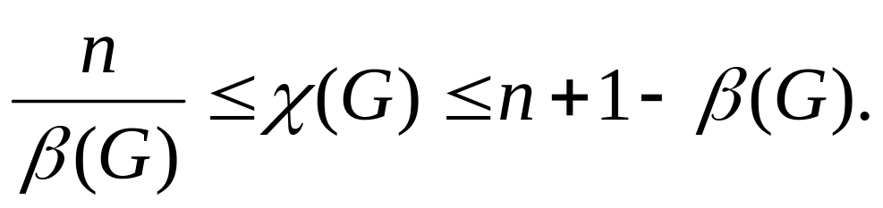
Theorem
For any graph G of order n,
MATH 323 Graph Theory Lecture 10

Slide 44
Example
Consider the graphs:
a
a
b
G₁
G₂
e
b
f
c
β(G₁)=2
d
c
β(G₂)=3
e
d
MATH 323 Graph Theory Lecture 10

Slide 45
Welch-Powell algorithm
Step 1. Write the vertices of G in order of decreasing degree in a row.
Step 2. Write the degree of the corresponding vertex in the second row.
Step 3. In the third row write the color C₁ for the first vertex and each of the other vertices on the list that is not adjacent to the first vertex.
Step 4. Proceed from the list of vertices with remaining highest degree with color C₂ and each of the non adjacent vertices.
Step 5. Continue the process until all the vertices have been colored.
MATH 323 Graph Theory Lecture 10

Slide 46
Example
Consider the graph G:
v₁
v₆
v₂
v₅
v₇
χ(G) = 3
v₄
v₃
Vertex v₇ v₃ v₅ v₄ v₂ v₁ v₆
Degree 4 4 3 3 3 3 2
Color C₁ C₂ C₁ C₃ C₃ C₂ C₂
MATH 323 Graph Theory Lecture 10

Slide 47
Exercise
Use Welch-Powell algorithm to find the chromatic number of the following graphs:
G₁
G₂
MATH 323 Graph Theory Lecture 10

Slide 48
Lecture will continue after break
MATH 323 Graph Theory Lecture 10

Slide 49
Coloring of Maps
Any map can be represented by a planar graph in the following way:
Represent each country on the map by a vertex.
Connect two vertices with an edge whenever the corresponding countries share a nontrivial border.
MATH 323 Graph Theory Lecture 10

Slide 50
Example
Consider the map:
MATH 323 Graph Theory Lecture 10

Slide 51
Example
Making the corresponding graph:
MATH 323 Graph Theory Lecture 10

Slide 52
Example
Corresponding planar graph:
MATH 323 Graph Theory Lecture 10

Slide 53
Exercise
Find the chromatic number of this graphs:
MATH 323 Graph Theory Lecture 10

Slide 54
The Four Color Problem
Is it true that the countries on any given map can be colored with four or fewer colors in such a way that adjacent countries are colored differently?
1852 – DeMorgan introduced the conjecture.
The four color conjecture is equivalent to the statement: Every planar graph is 4-colorable.
MATH 323 Graph Theory Lecture 10

Slide 55
Four Color Problem
In 1976 Appel and Haken proved the conjecture positively.
The proof consists of two parts:
Part of the proof uses computer and cannot be verified by hand.
The part that is supposedly hand-checkable has not been independently verified in its entirety.
MATH 323 Graph Theory Lecture 10

Slide 56
Five Color Theorem
Every planar graph is 5-colorable.
MATH 323 Graph Theory Lecture 10

Slide 57
Chromatic Polynomials
Given a graph G, suppose that its vertices are labeled v₁, v₂, . . ., v_{n}. A coloring of G is an assignment of colors to these vertices, and we call two colorings C₁ and C₂ different if at least one v_{i} receives a different color in C₁ that it does in C₂.
MATH 323 Graph Theory Lecture 10

Slide 58
Example
Two different coloring of K₄.
v₁
v₂
v₁
v₂
v₄
v₃
v₄
v₃
MATH 323 Graph Theory Lecture 10

Slide 59
No. of different colorings
Define by C_{G}(k) the number of different colorings of a graph G using at most k colors.
C_{Kn}(k) = k(k-1)(k-2). . . (k-n+1)
e.g. C_{K4}(4) = 24
C_{K4}(6) = 360
Note: C_{Kn}(k) = 0 if k<n; C_{En}(k) = k^{n.}
MATH 323 Graph Theory Lecture 10

Slide 60
Property of C_{G}(k)
Graph G is k-colorable if and only if C_{G}(k) > 0.
Equivalently, C_{G}(k) > 0 if an and only if χ(G) ≤ k.
MATH 323 Graph Theory Lecture 10

Slide 61
Graph G/e
Let G be a graph and let e be an edge of G.
Remember G – e denotes the graph where e is removed from G.
Define the graph G/e to be the graph obtained from G by removing e, identifying the end vertices of e, and leaving only one copy of any resulting multiple edges.
MATH 323 Graph Theory Lecture 10

Slide 62
Example
G - bc
G
a
a
w
z
w
z
b
c
b
c
x
y
G/bc
a
w
z
x
y
b & c
x
y
MATH 323 Graph Theory Lecture 10

Slide 63
Theorem
Let G be a graph and e be any edge of G, Then
C_{G}(k) = C_{G-e}(k) – C_{G/e}(k).
MATH 323 Graph Theory Lecture 10

Slide 64
Example
Find C_{P4}(k).
C_{P4}(k) = C_{P4-e1}(k) – C_{P4/e1}(k)
e1
e2
e3
MATH 323 Graph Theory Lecture 10

Slide 65
Example (contd.)
Denote P4-e1 by G11 and P4/e1 by G12.
Then,
C_{P4}(k) = C_{G11-e2}(k) – C_{G11/e2}(k) – C_{G12-e2}(k) + C_{G12/e2}(k)
G11
G12
e2
e3
e2
e3
MATH 323 Graph Theory Lecture 10

Slide 66
Example (contd.)
Denote: G11-e2 by G21; G11/e2 by G22;
G12-e2 by G23; G12/e2 by G24.
Again,
C_{P4}(k) = C_{G21-e3}(k) – C_{G21/e3}(k) – C_{G22-e3}(k) + C_{G22/e3}(k) – C_{G23-e3}(k) + C_{G23/e3}(k) + C_{G24-e3}(k) - C_{G24/e3}(k).
Exercise: Draw – G21; G22; G23 and G24.
MATH 323 Graph Theory Lecture 10

Slide 67
Example (contd.)
Finally,
C_{P4}(k) = C_{E4}(k) – C_{E3}(k) – C_{E3}(k) + C_{E2}(k) – C_{E3}(k) + C_{E2}(k) + C_{E2}(k) – C_{E1}(k)
= k⁴ – k³ – k³ + k² – k³ + k² + k² – k
= k⁴ – 3k³ + 3k² – k.
e.g.: C_{P4}(1) = 0.
C_{P4}(2) = 2.
MATH 323 Graph Theory Lecture 10

Slide 68
Exercise
Find chromatic polynomials for:
a. K_{1,3}
b. C₄
MATH 323 Graph Theory Lecture 10

Slide 69
More Next Time
MATH 323 Graph Theory Lecture 10

